Slide 1
TODO LIST SAMPLE APP
Yet another todo list
Bringing HTML, CSS, JS, and React together
https://github.com/tnt-summer-academy/Curriculum-2022/blob/main/Week%202/%5BENG2.0%5D%20To%20Do%20sample%20app.md
Created for Microsoft / TNTs

Slide 2
Learning objectives
TNTs will understand how the intro blocks of HTML, CSS, JS and React, are used in the app.
TNTs will learn how to add a React component and JS logic, manage app props, and add input that affects the app.

Slide 3
DO NOT CREATE REPOS IN TNT-SUMMER

Slide 4
PART 1 GET THE CODE
https://github.com/tnt-summer-academy/Exercises/tree/main/Week_2/ENG2.0-todos-via-classes

Slide 5
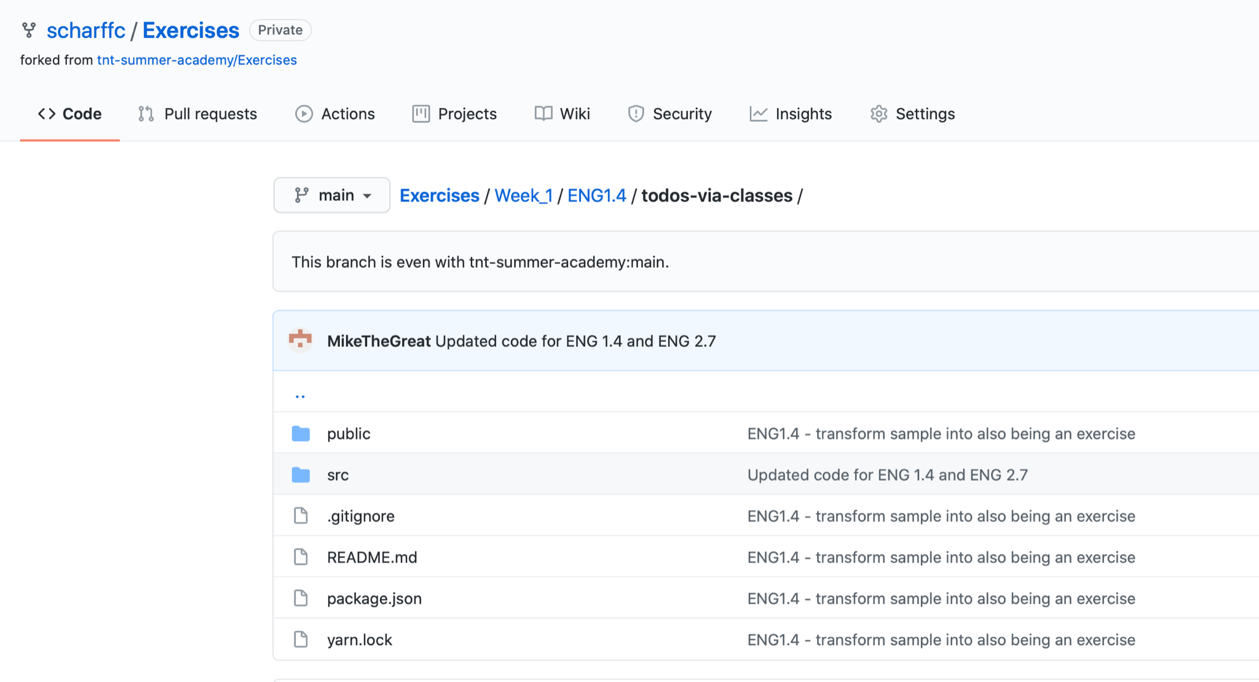
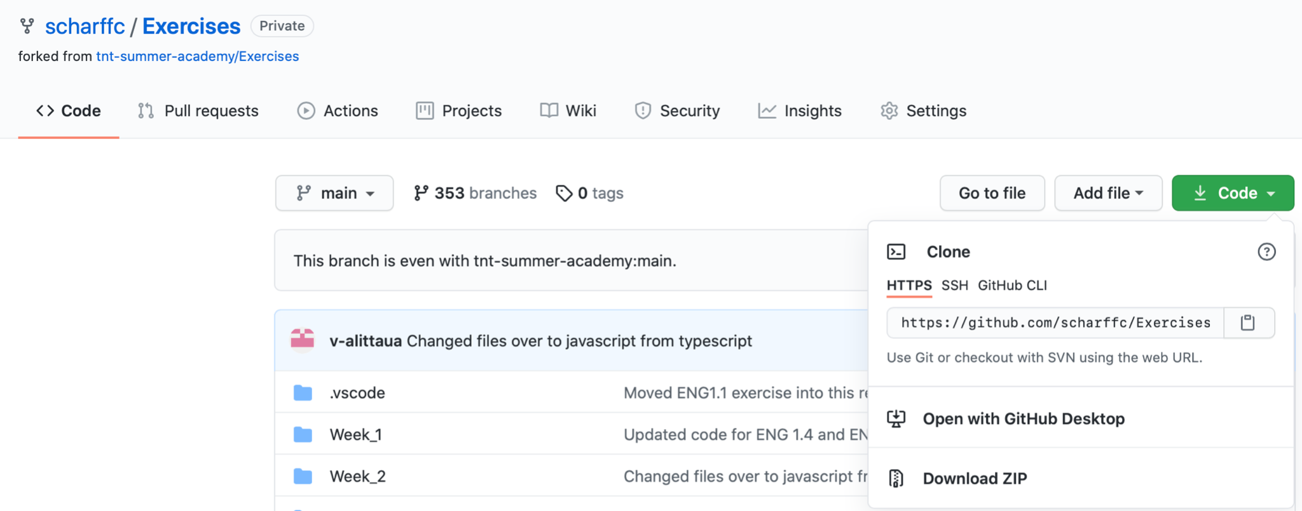
Fork and clone
Fork the repo Exercises
The code is now on your account
Clone the repo to your machine
Go to the code
Open VS Code
Go to the code
Open the terminal
Do npm install
Do npm start
git clone https://github.com/scharffc/Exercises.git

Slide 6
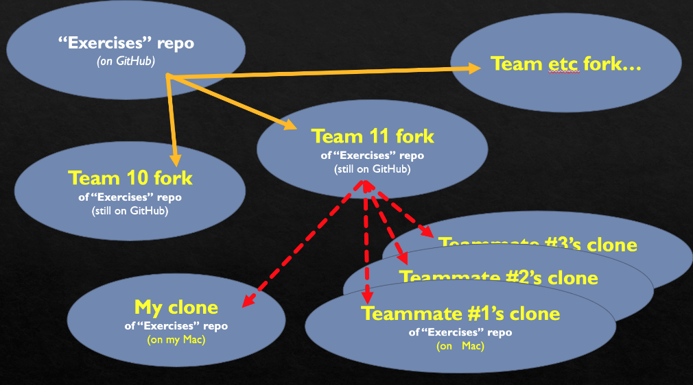

Slide 7
If you have problems with npm install …
READ THE ERROR MESSAGES AND SUGGESTIONS
npm fund
npm audit fix --force
Remove package-lock.json and nodes folder
Add a .env file with SKIP_PREFLIGHT_CHECK=true

Slide 8
PART 2 EXECUTE THE APP

Slide 9
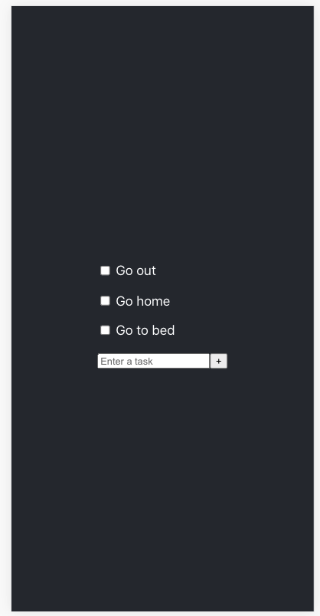
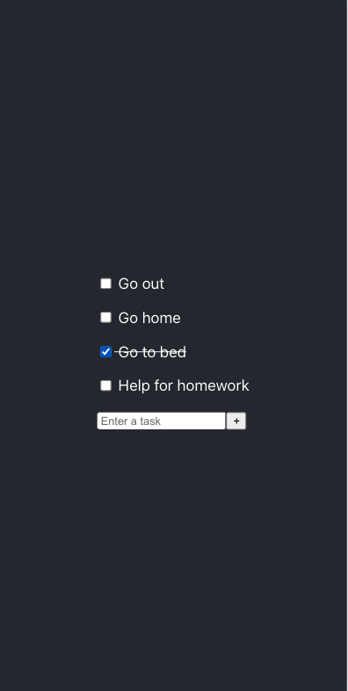

Slide 10
What are the components of the app ?
Draw them on paper
Are they stateful or stateless?

Slide 11
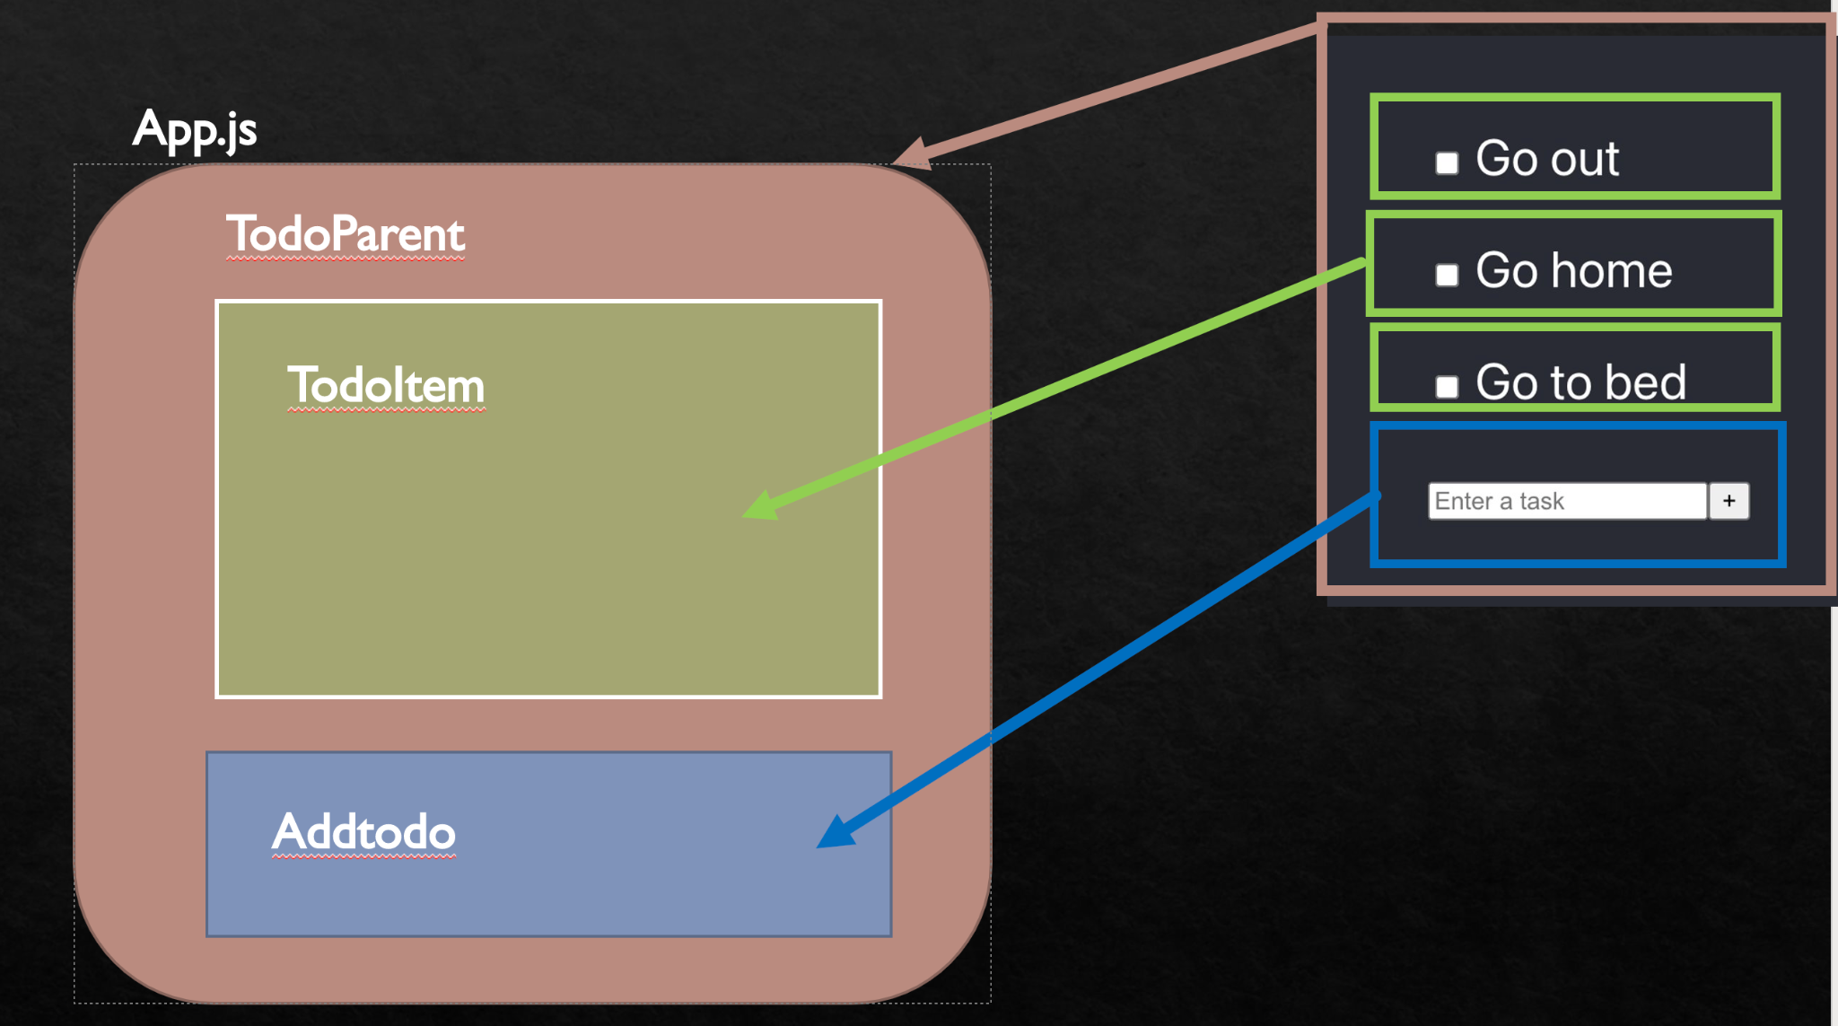
TodoItem
Todo Item

Slide 12
PART 3 EXPLORE THE FILES AND CODE

Slide 13
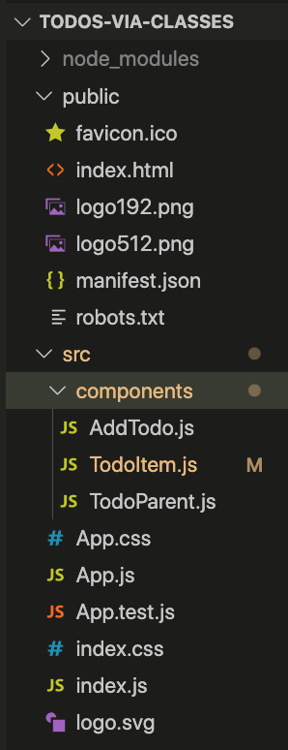
Organization of the files /
code
Starting point
index.html
index.css
App.js
App.css
Each component is in a file
All components are in the folder components

Slide 14
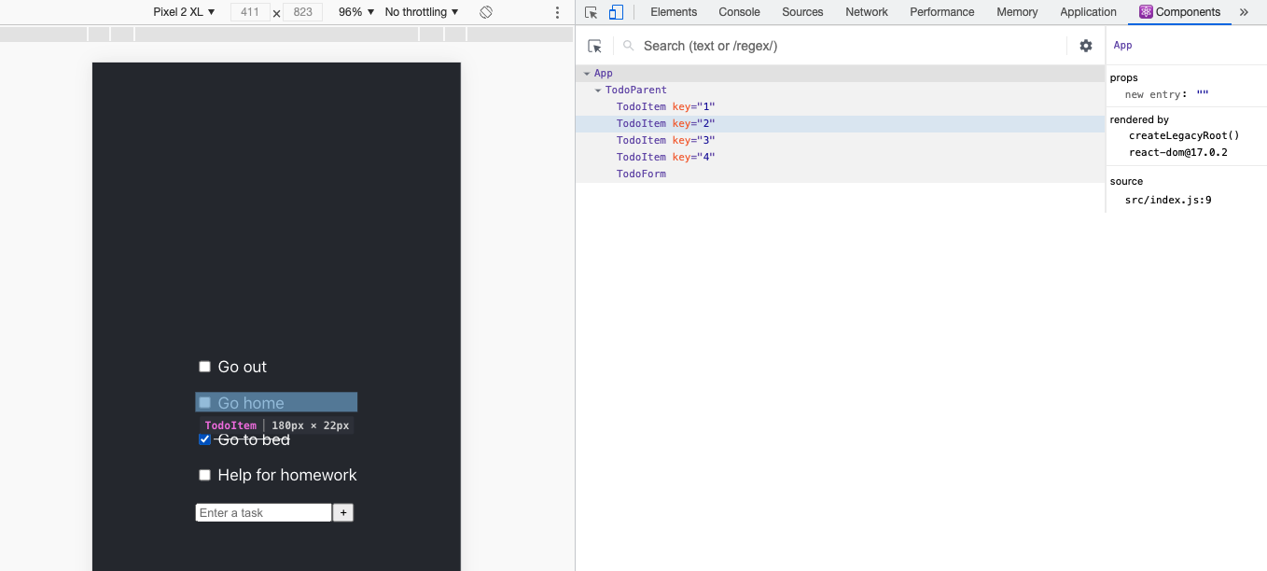
What are the components of the app ?
Install the Google Chrome React Tools extension
https://chrome.google.com/webstore/detail/react-developer-tools/fmkadmapgofadopljbjfkapdkoienihi?hl=en

Slide 15
General comment on how the code was written
TodoParent handles the state
TodoParent passes the state down to the child components (Todos and TodoItems)
The child components treat the data as props
When a TodoItem is clicked that component tells TodoParent to change that particular TodoItem
TodoParent then tells its children to render so that the page is updated
There are other ways to write the code

Slide 16
General comment on how to code
Start with the render() method & UI
then
add the logic

Slide 17
PART 4 App.js
What type of component is it? Could it have been something else?
What is render()?
How is App.js styled? Change the style.
Why these imports?

Slide 18
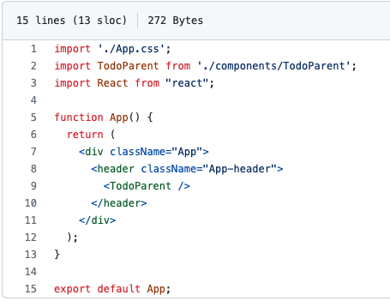

Slide 19
PART 5
TodoParent.js

Slide 20
TodoParent.js
TodoParents is a container class. It coordinates the data
It displays the todo items
What type of component is it? Could it have been something else?
What is the state?
What is the function we will be using to change the state?
What is render()? What does it render?
Why these imports?
What are the functions of TodoParent?

Slide 21
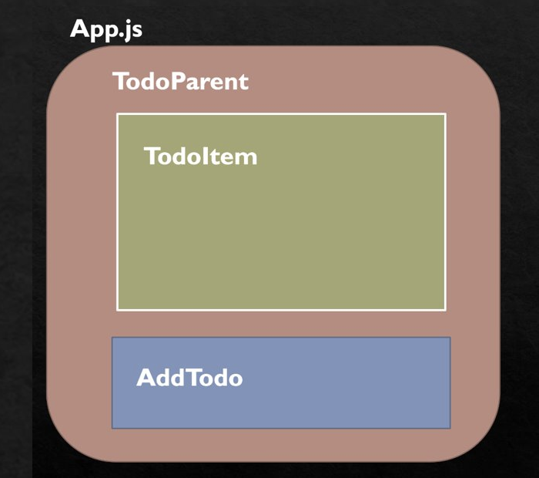
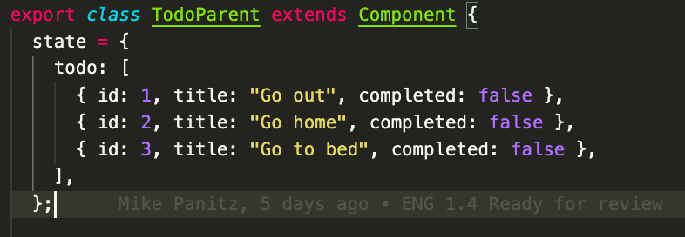
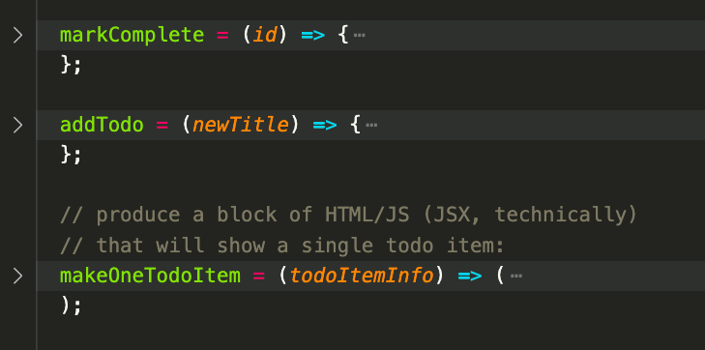
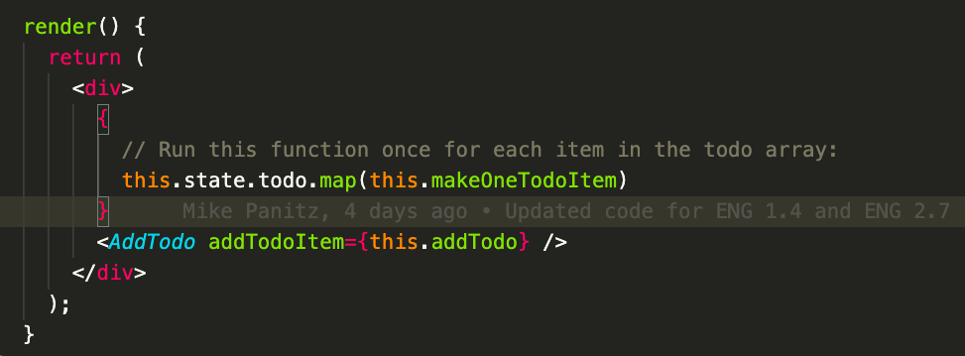
TodoParent.js
TodoItem
TodoItem
// cross out the item when we click on the checkbox
// add item to the list when we click on the button
// create an item component - id, title and status

Slide 22
PART 6
TodoItem.js

Slide 23
TodoItem.js
TodoItem displays a single todo item
It sets things up so that when the user clicks on the checkbox the item will be marked as completed, which will cause the item to re-render
What type of component is it? Could it have been something else?
How to get the id, title and completed attributes of a TodoItem?
How, in the code, is a completed item crossed-out?
What is the function we will be using to change the state?
What is render()? What does it render?
How is it called?

Slide 24
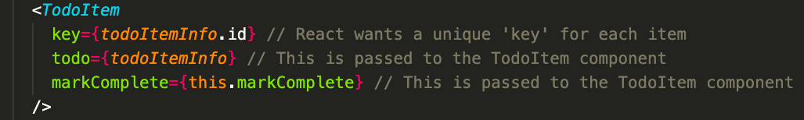

Slide 25
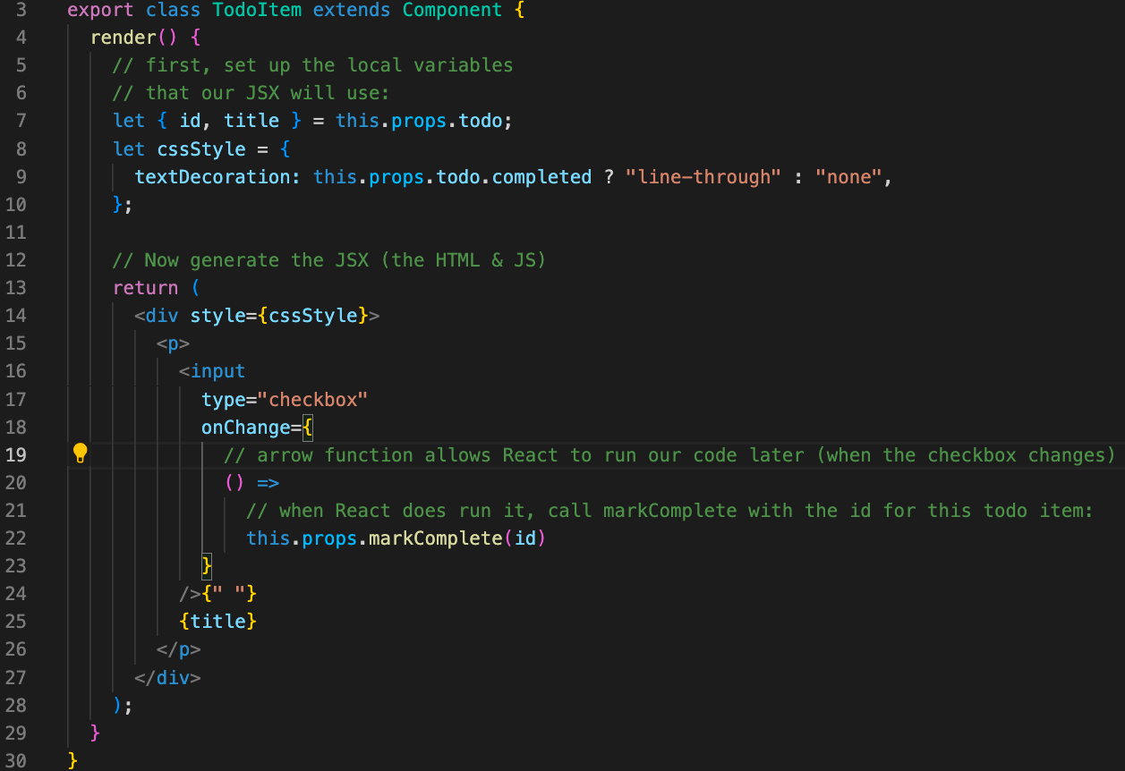
TodoItem.js

Slide 26
PART 7
Logic of the program

Slide 27
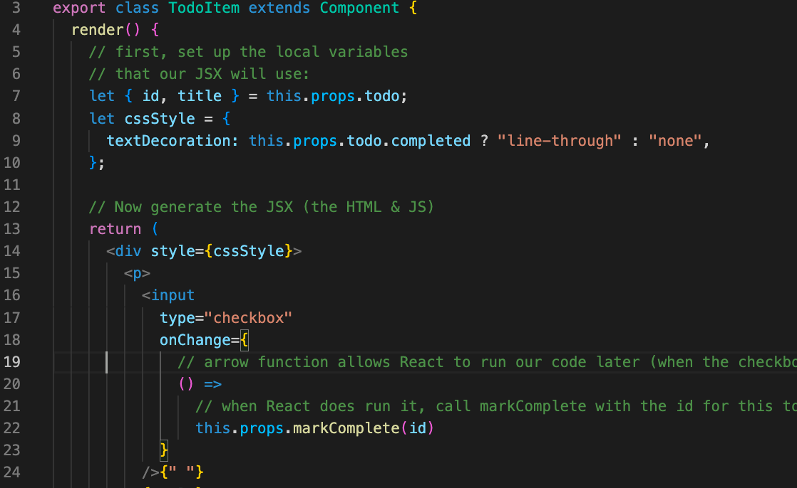
TodoItem.js
How is an item’s completed status toggled in the app?

Slide 28
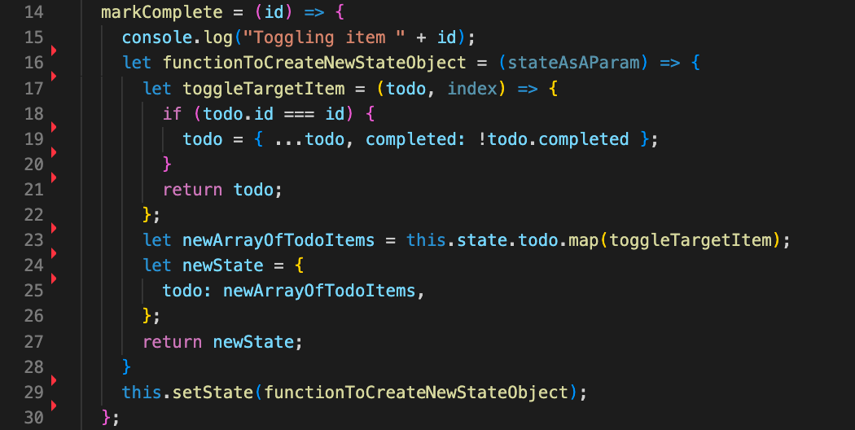
TodoParent.js
How is an item’s completed status toggled in the app?

Slide 29
AddTodo.js
What type of component is it? Could it have been something else?
What is render()? What does it render?
How is it called?
What is ref?

Slide 30
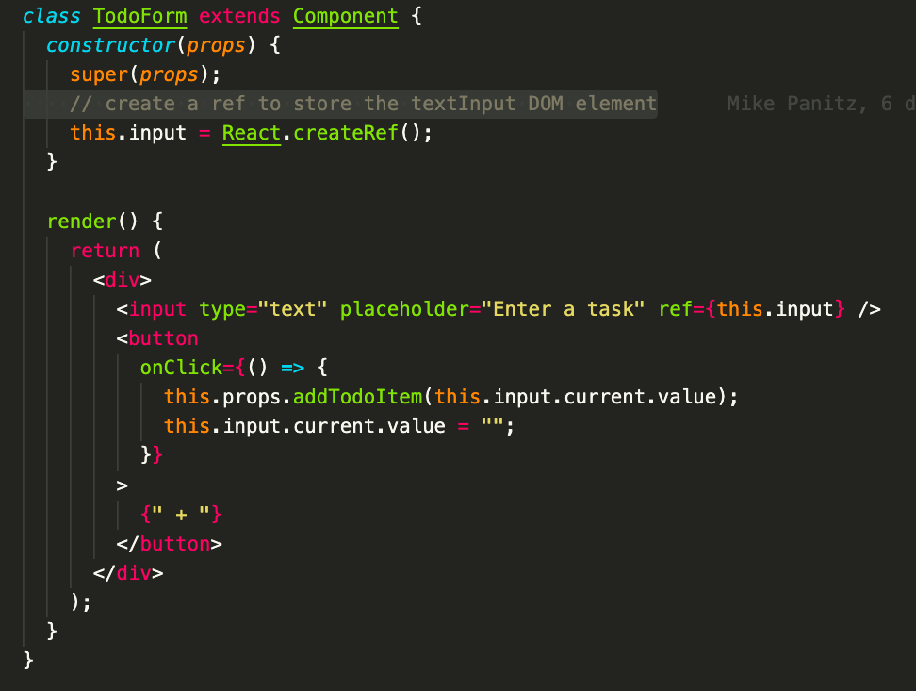
AddTodo.js

Slide 31
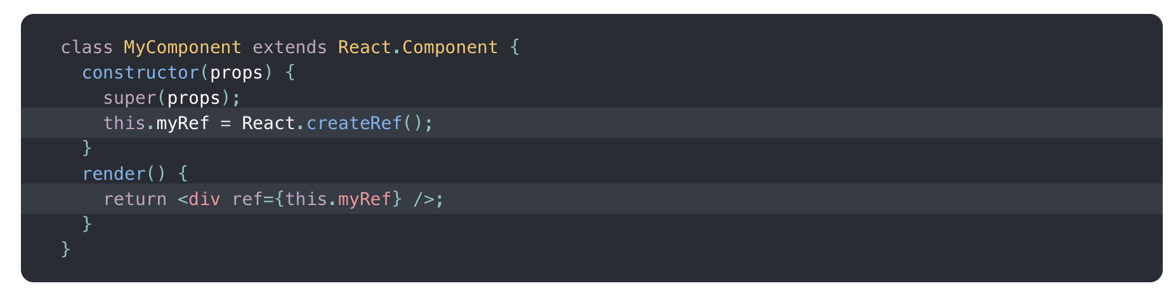
Ref
https://reactjs.org/docs/refs-and-the-dom.html
Don’t overuse ref!
Ref is attached to a React element

Slide 32
PART 8
Your turn

Slide 33
Team 6 (Change styling):​
Add static styling (in other words, find an element(s) on the page and put some styling in the .CSS file to make the element look different)​
When item is checked change the style more, in addition to the strike-through that's currently being applied (for example, can you make completed items appear to be grayed-out, italicized, and struck-through?)​
When item is checked change the style by using one of two styles in CSS (instead of listing out all the CSS attributes you want to set, inline)​
Team 7 (Change what the user sees)​
Can you number the todo items? Can you do this using the ordered list element(s) in HTML?​
Add fields to the items​ (on top of key, todo and markComplete)
Maybe another text field - one text field could be the item's title, and the other could be used to describe the item​
Maybe having an assignedTo field? Priority? Feel free to come up with any (workplace appropriate) fields that you'd like.​
​
Team 8 (Make sure that the input is valid)​
Check for empty inputs​
Check if the new item duplicates an existing item​
You might start by using alert() to describe the error, but it would be interesting to try putting an error message on the page next to the textbox instead.​
Team 9​ (Add delete functionality)
Add delete() functionality​
Team 10​ (Sort the list)
Sort the list alphabetically​

Slide 34
Your turn - In your teams
WE RECOMMEND DOING A COUPLE OF THE BELOW EXERCISES BEFORE MOVING ON TO THE FOLLOWING:
Add static styling (in other words, find an element(s) on the page and put some styling in the .CSS file to make the element look different.)
When item is checked change the style more, in addition to the strike-through that's currently being applied (for example, can you make completed items appear to be grayed-out, italicized, and struck-through?)
When item is checked change the style by using one of two styles in CSS (instead of listing out all the CSS attributes you want to set, inline)
Try changing what the user sees on the page. For example, can you number the todo items? Can you do this using the ordered list element(s) in HTML?
Add fields to the items
Maybe another text field - one text field could be the item's title, and the other could be used to describe the item
Maybe having an assignedTo field? Priority? Feel free to come up with any (workplace appropriate) fields that you'd like.
Make sure that the input is valid:
Check for empty inputs
Check if the new item duplicates an existing item
You might start by using alert() to describe the error, but it would be interesting to try putting an error message on the page next to the textbox instead.
Add delete() functionality
Sort the list alphabetically
What other changes, improvements, and/or modifications would you like to add to the app? After checking in with your small group try adding them
What features are you thinking about adding to your TNT Prototype project? If any of those features look like you might reasonably try adding them to this Todo app, feel free to try adding them (after checking with your small group, of course). By 'reasonable' I mostly mean 'does it look like you can figure it out', not 'does it make sense in the context of a todo app'.

Slide 35
Stretch
Add categories, set up the todo lists to show items by category
"Reflect on your experience"

